Slide 1
License asset management system CS 5320 software design fall 2024 team 10: johnny king & john Williams instructor: dr. A. Moin TA: Aryan Padiyal

Slide 2
Agenda
Introduction
Start with Why
What
How
Analysis
Work Breakdown, Task Distribution
Planning and Progress
Research Paper
Conclusion
Q & A

Slide 3
Team 10
John Williams
Graduate Student
Johnny Colby King
Graduate Student

Slide 4

Why
Software Developers need a way to control who can use their software.
Government regulations
For profit
Other reasons

Slide 5
What
The License Asset Management System is an online store that sells and manages software subscriptions.
The prototype the team is building is a centralized system, but for production, the final system will be a distributed system.

Slide 6
How
The License Asset Management System is implemented as a SaaS application.
The system is built using ASP.Net Core technology running on a Windows machine.
The Systems web page will allow guest to create accounts and obtain subscriptions for different software products. Subscriptions may be free, or fee based, depending on the software developers request.
The System will also provide Admin users special privileges.
Software developers will have access to an SDK that will enable their products to require subscriptions to function.

Slide 7
analysis/Requirements

Slide 8
The 8 Architecture design decisions
Is there a generic application architecture that can act as a template?
How will the system be distributed across hardware cores?
What architectural patterns might be used?
What strategy will be used to control the components of the system?
How should the architecture be documented?
What architectural organization is best for delivering the non-functional requirements?
How will components be decomposed into sub-components?
What approach will be used to structure the system?

Slide 9
Functional Requirements
Guest can access homepage/account information
Software Developer can add subscriptions/products to store
Admin can manage data
Guest can search for products by category(keyword implementation later)
Guest can make purchases in store/start subscription
Software Developer can query subscription reports from database

Slide 10
Non-functional Requirements
Design shall follow sound software engineering practices
Customer data will be secure with only admin and personal access (Security)
Code will maintainable and reusable with proper software conventions (Maintainability)
Code will have unit testing to ensure system meets customer needs (Maintainability)
UI will use Bootstrap to provide a pleasant user experience (Usability + Compatibility)
Multi-tier architectural pattern for larger (Scalability)
Website shall be available for 99% of the time (Availability)
All responses shall be less than 2 seconds (Performance)

Slide 11
Work breakdown/Implementation

Slide 12
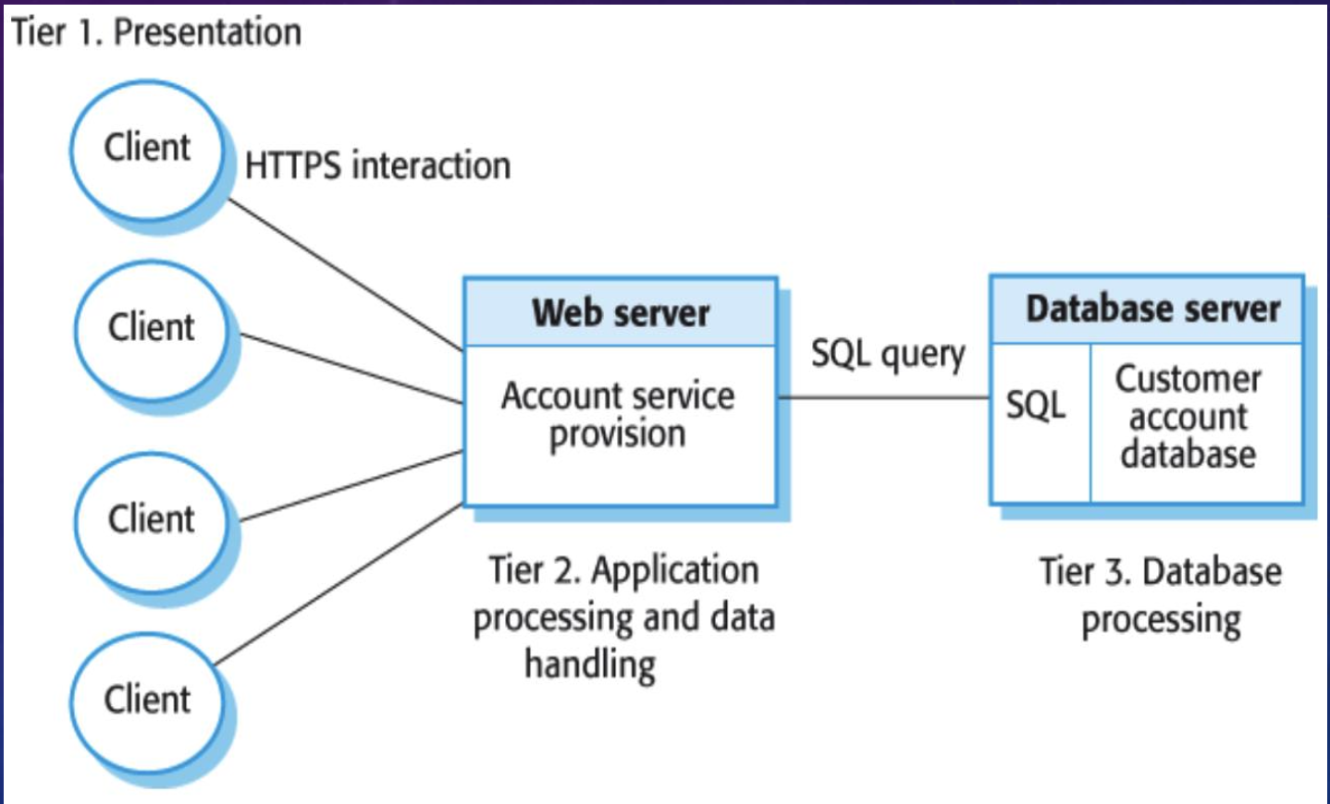
Multi-tier Client Server Architectural Pattern
Good for large volume of transactions
Able to scale as more clients sign up for the service it will be better for larger scale
Good for applications where data is volatile

Slide 13
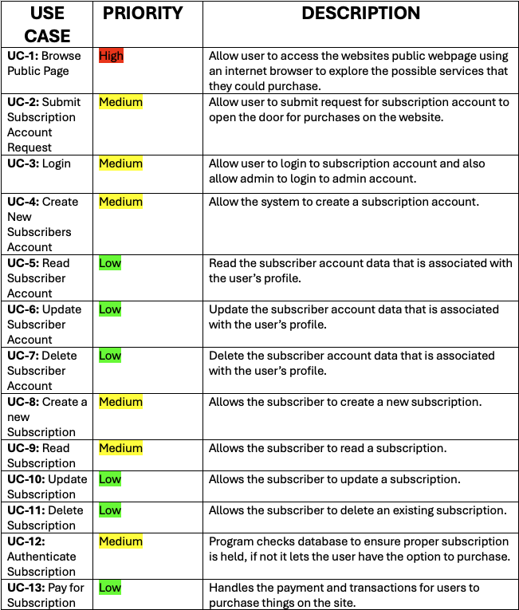
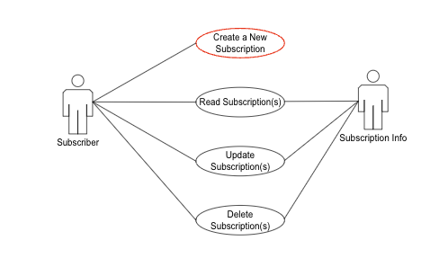
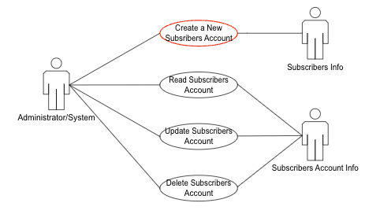
Use case / UML diagrams

Slide 14
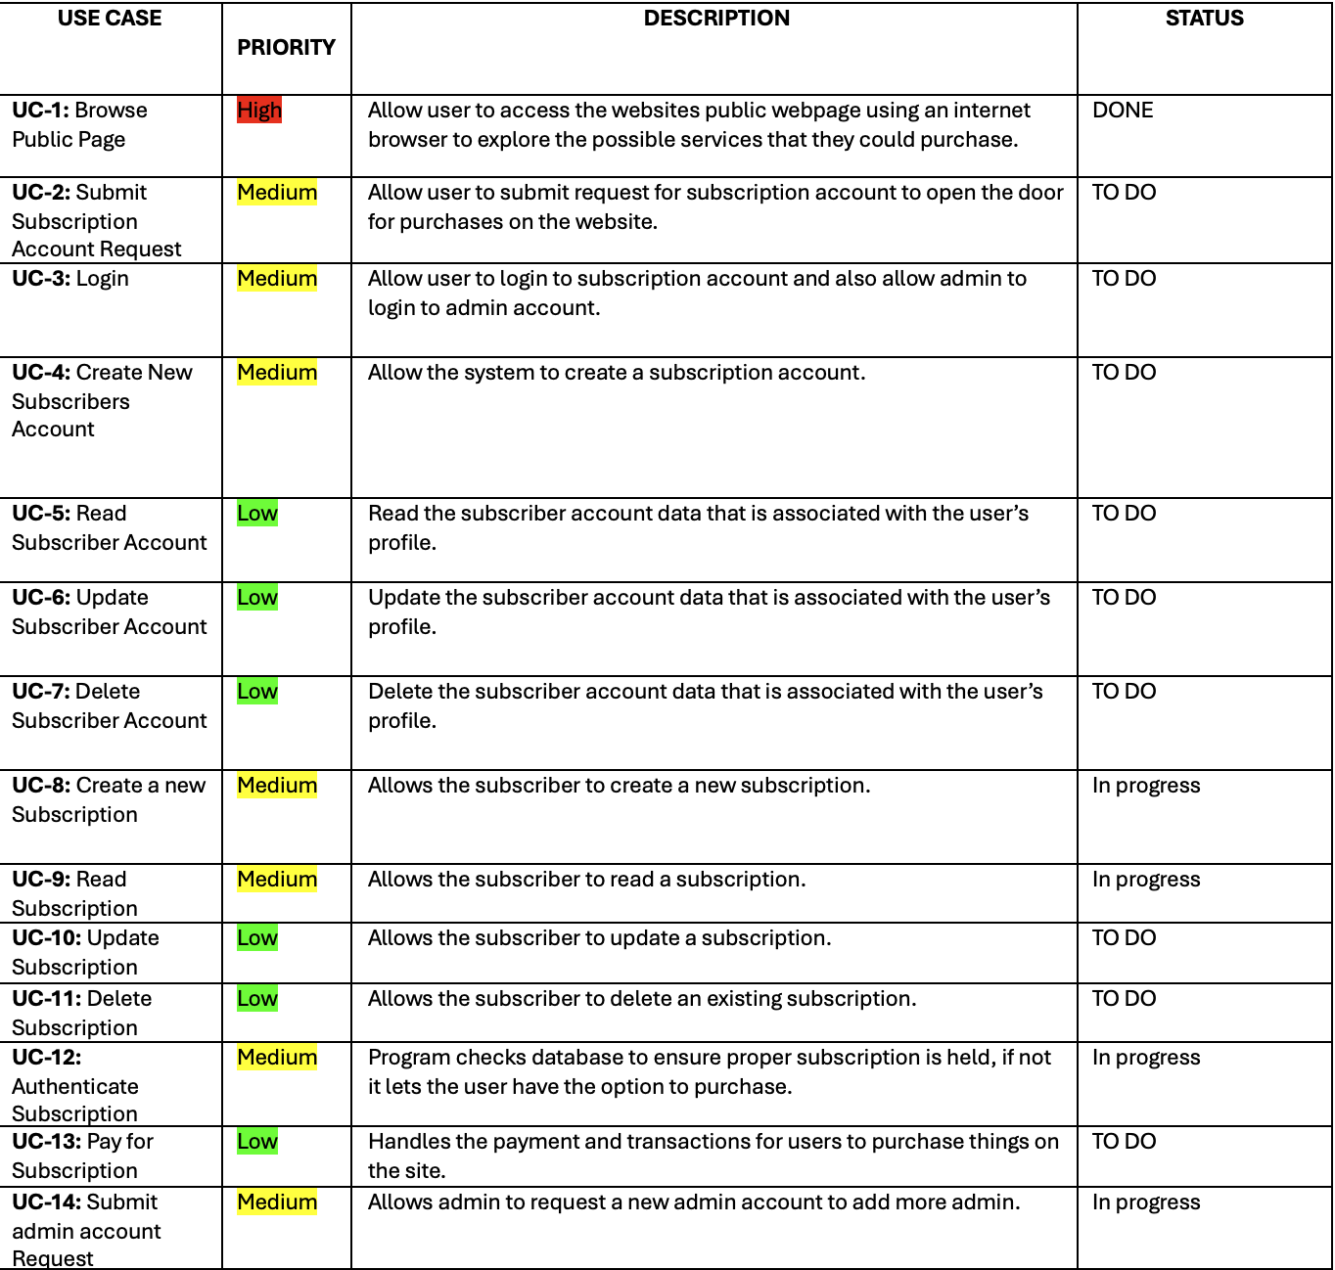
Design process add 3.0 iteration

Slide 15
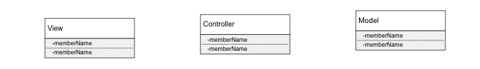
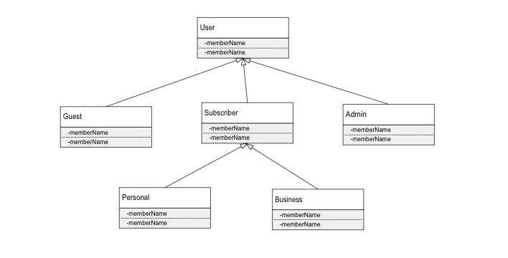
Class Diagrams
NOTE: Class diagrams will be updated as the coding progresses

Slide 16
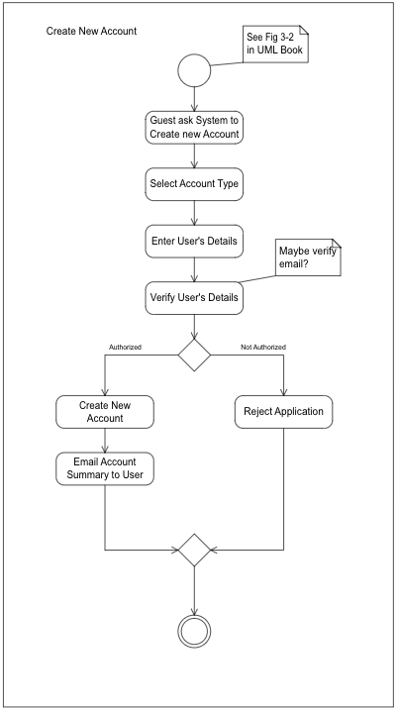
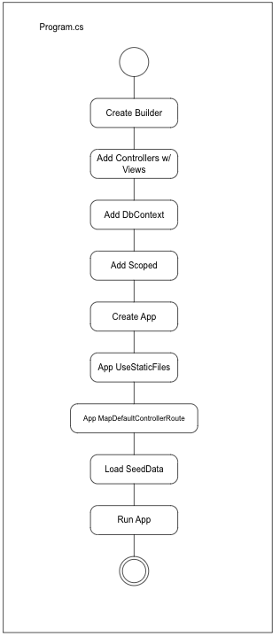
Activity Diagrams

Slide 17
Task distribution

Slide 18
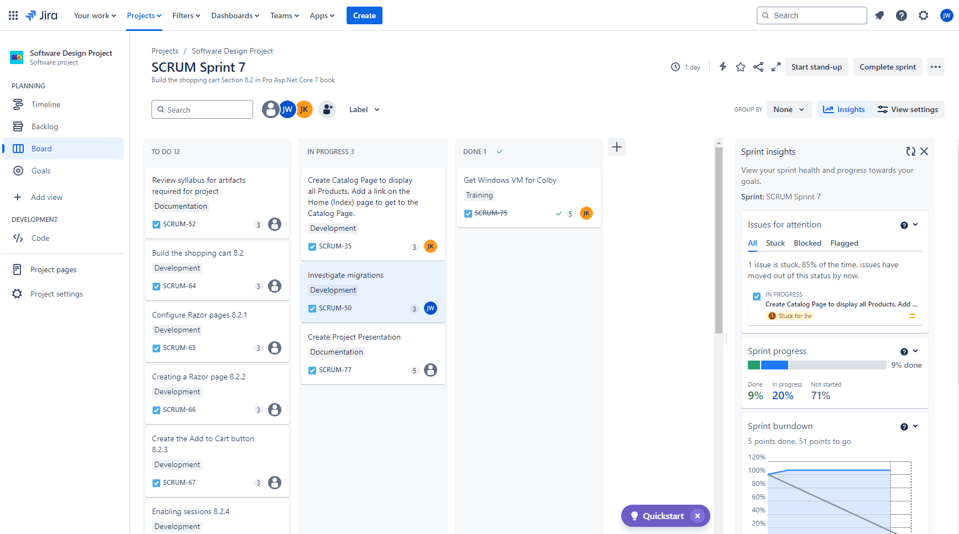
Planning and progress using jira

Slide 19
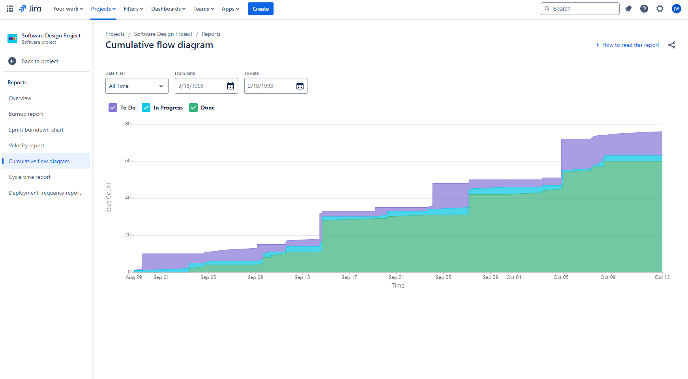
My favorite jira report! Cumulative flow diagram

Slide 20
Research paper

Slide 21
Topic
Advantages of using large drawings to document Software Products

Slide 22
Related work
Residential Architects have been using large drawings to convey information for more than a century and the method has worked to a large degree.
The standard size of large drawing paper is 24” x 36”.

Slide 23
Novel contributions
Currently, I am not aware of any major reference books on software documentation that suggest using large paper drawing to convey software product information.

Slide 24
evaluation
We are currently constructing drawings on large electronic paper, 24” x 36”, to document our project.
We will evaluate their effectiveness by allowing others to view the drawings and provide feedback on their ease of understanding and completeness.

Slide 25
conclusion
We have shown the Why, What, and How that is driving our projects development.
We have shown the planning that has went into the development of our project to achieve success.
We have shown the current progress of our project.
We have provided some analysis of the project and the drivers behind it.
We have presented the topic of our research paper and some of the ideas we have in that regard.
We thank you for your attention!

Slide 26
Q & A

Slide 27
Thank you
Johnny King & John Williams
jking4@uccs.edu
jwilli11@uccs.edu

Slide 28

The power of communication

Slide 29

Overcoming nervousness
Confidence-building strategies

Slide 30
Engaging the audience
Make eye contact with your audience to create a sense of intimacy and involvement
Weave relatable stories into your presentation using narratives that make your message memorable and impactful
Encourage questions and provide thoughtful responses to enhance audience participation
Use live polls or surveys to gather audience opinions, promoting engagement and making sure the audience feel involved

Slide 31
Selecting visual aids
Enhancing your presentation

Slide 32
Effective delivery techniques
This is a powerful tool in public speaking. It involves varying pitch, tone, and volume to convey emotion, emphasize points, and maintain interest:
Pitch variation
Tone inflection
Volume control
Effective body language enhances your message, making it more impactful and memorable:
Meaningful eye contact
Purposeful gestures
Maintain good posture
Control your expressions

Slide 33
Navigating Q&A sessions
Know your material in advance
Anticipate common questions
Rehearse your responses
Maintaining composure during the Q&A session is essential for projecting confidence and authority. Consider the following tips for staying composed:
Stay calm
Actively listen
Pause and reflect
Maintain eye contact

Slide 34

Speaking impact
Your ability to communicate effectively will leave a lasting impact on your audience
Effectively communicating involves not only delivering a message but also resonating with the experiences, values, and emotions of those listening

Slide 35
Dynamic delivery
Learn to infuse energy into your delivery to leave a lasting impression
One of the goals of effective communication is to motivate your audience
Metric | Measurement | Target | Actual
Audience attendance | # of attendees | 150 | 120
Engagement duration | Minutes | 60 | 75
Q&A interaction | # of questions | 10 | 15
Positive feedback | Percentage (%) | 90 | 95
Rate of information retention | Percentage (%) | 80 | 85

Slide 36
Final tips & takeaways
Consistent rehearsal
Strengthen your familiarity
Refine delivery style
Pacing, tone, and emphasis
Timing and transitions
Aim for seamless, professional delivery
Practice audience
Enlist colleagues to listen & provide feedback
Seek feedback
Reflect on performance
Explore new techniques
Set personal goals
Iterate and adapt

Slide 37
Navigating Q&A sessions
Impact factor | Measurement | Target | Achieved
Audience interaction | Percentage (%) | 85 | 88
Knowledge retention | Percentage (%) | 75 | 80
Post-presentation surveys | Average rating | 4.2 | 4.5
Referral rate | Percentage (%) | 10 | 12
Collaboration opportunities | # of opportunities | 8 | 10

